Slide 1
26th April Update
Overview
Update on eye annotations
Need doctor consultation
Update on combined model

Slide 2
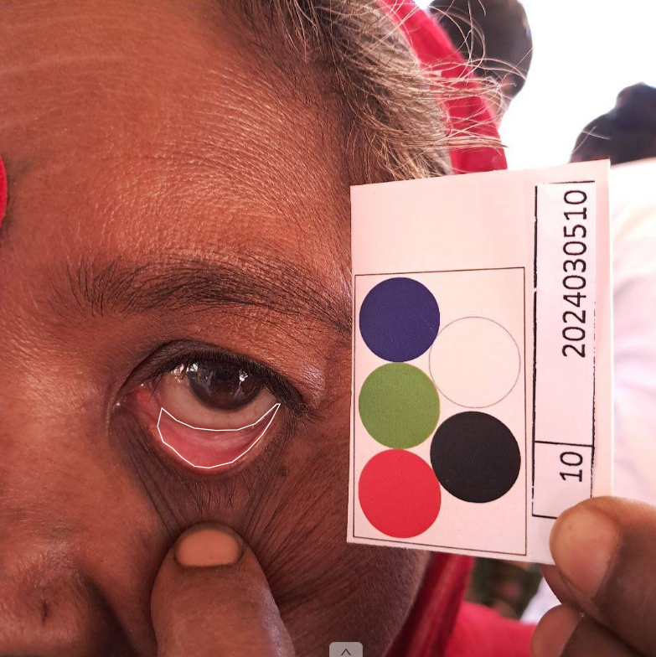
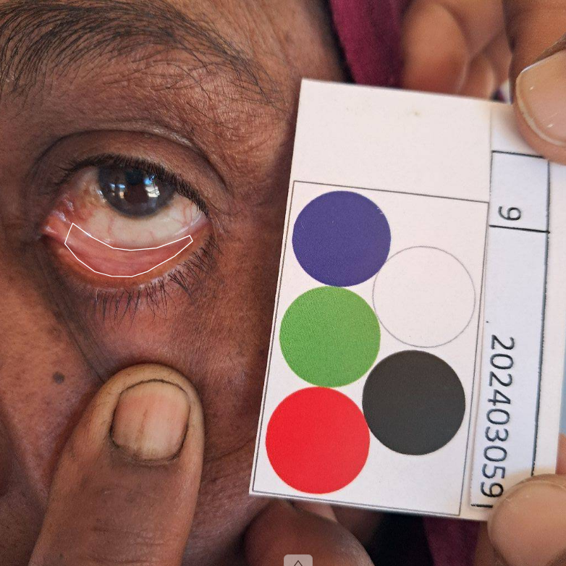
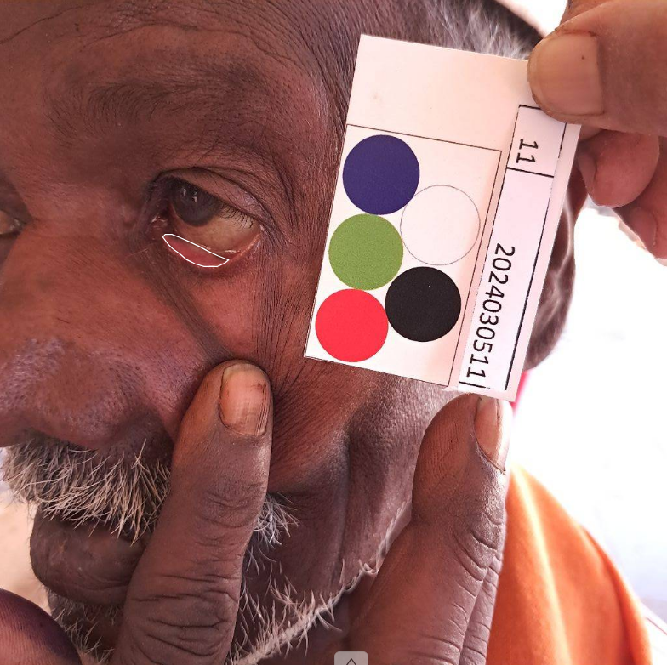
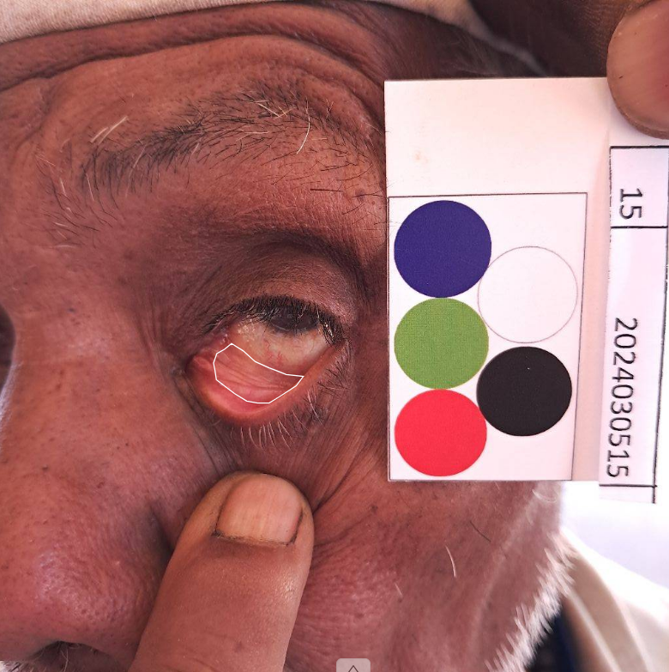
Eye Annotations
Relatively Good Images
Poor Angle and Ambiguous Images

Slide 3
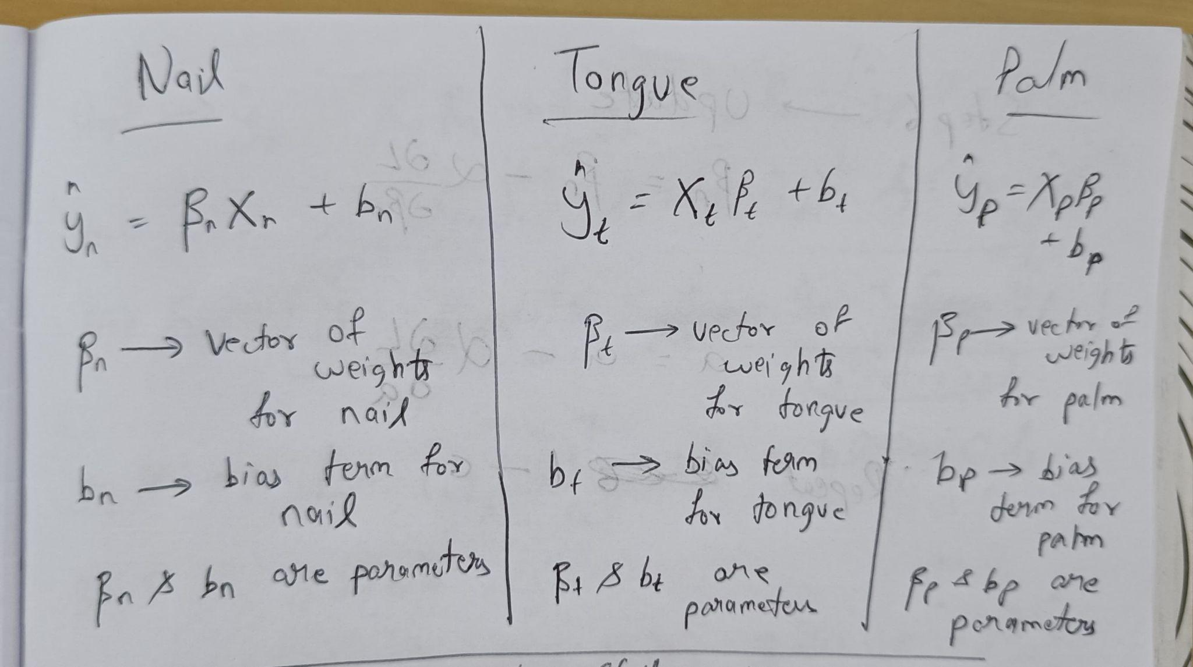
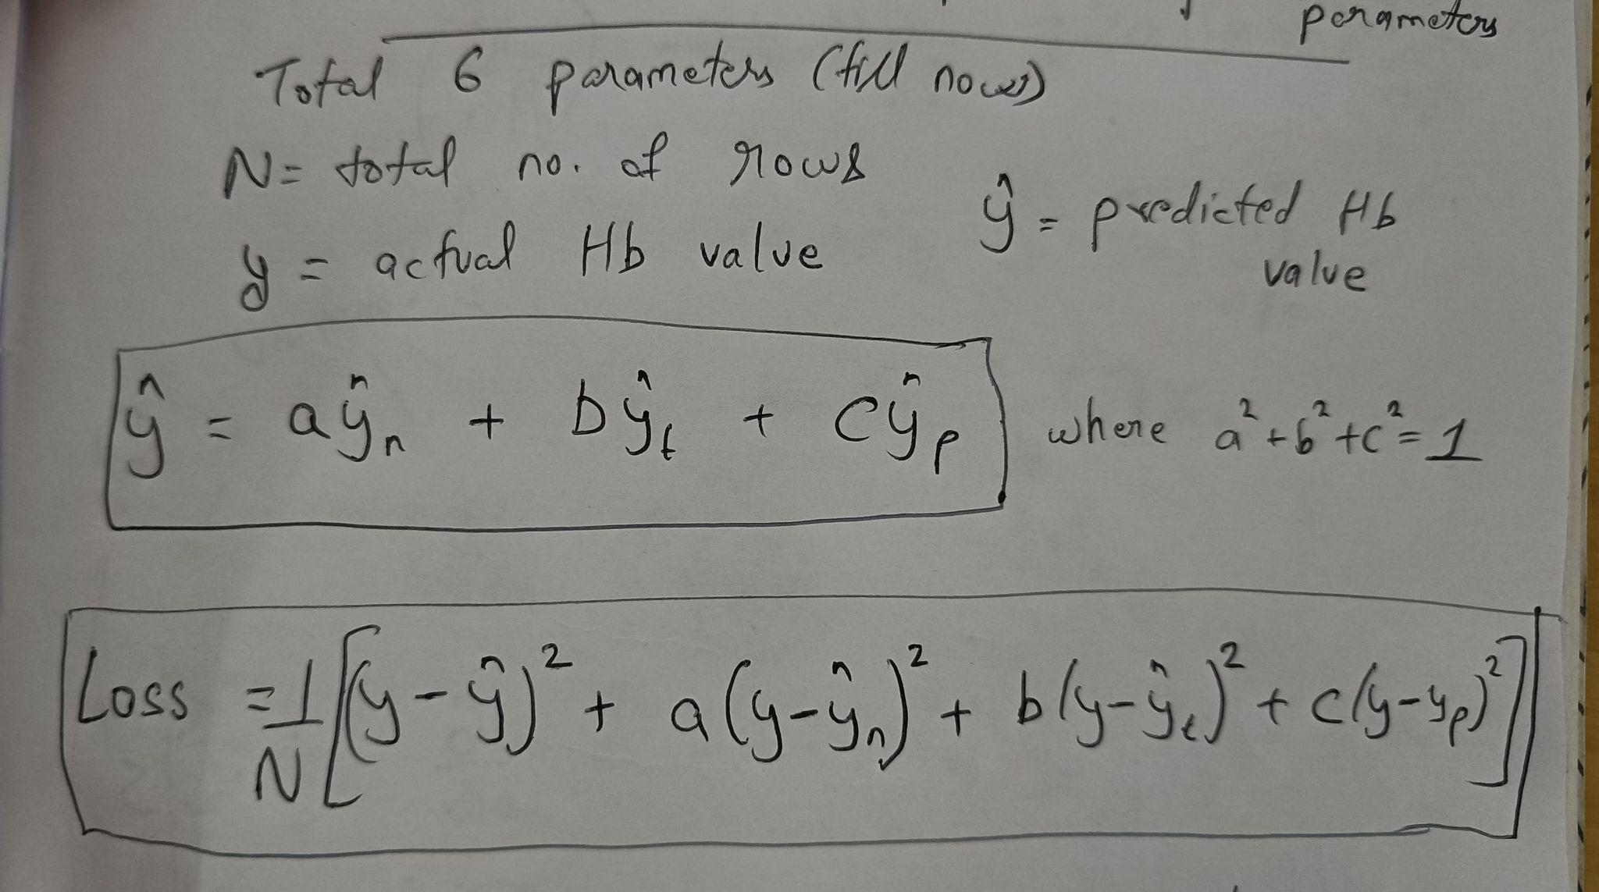
Combined Model
Overview
Performing 3 separate linear regression for each of nail, palm and tongue
Then calculating the final prediction using weighted sum of each of the 3 prediction (i.e. nail, palm and tongue)
P.S. - The weights of the each of the prediction are also parameters
Calculating only one combined loss and using it to update all the parameters
Using the combined loss to update the parameters
Repeating until the loss converges
Step 1
Step 2

Slide 4
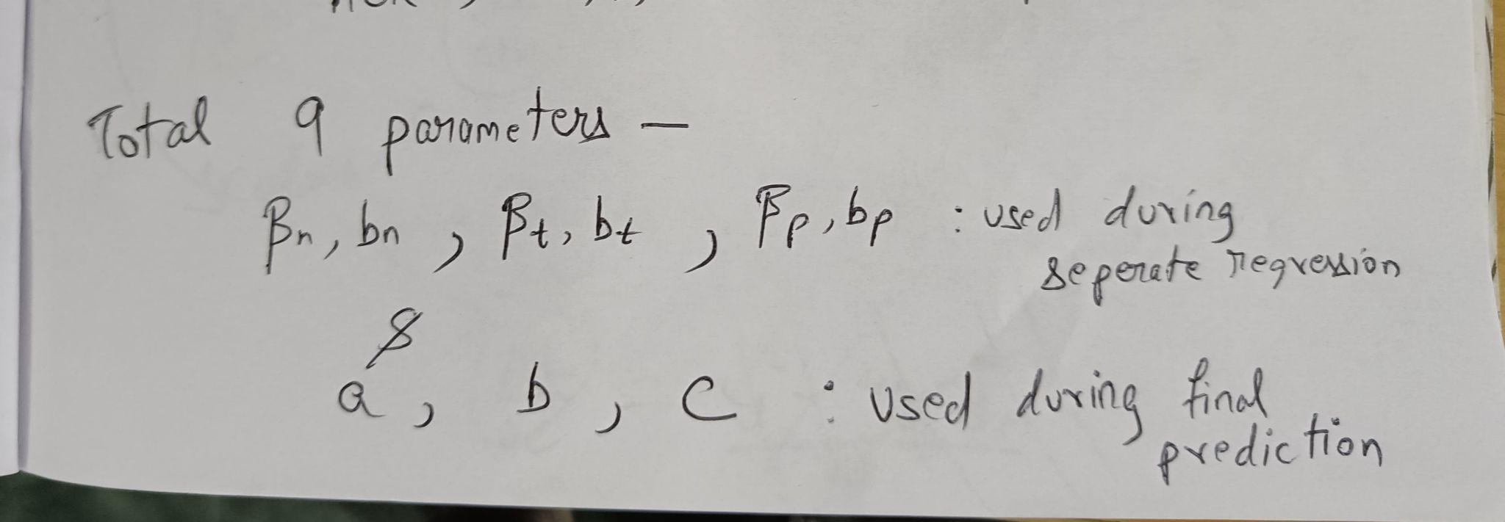
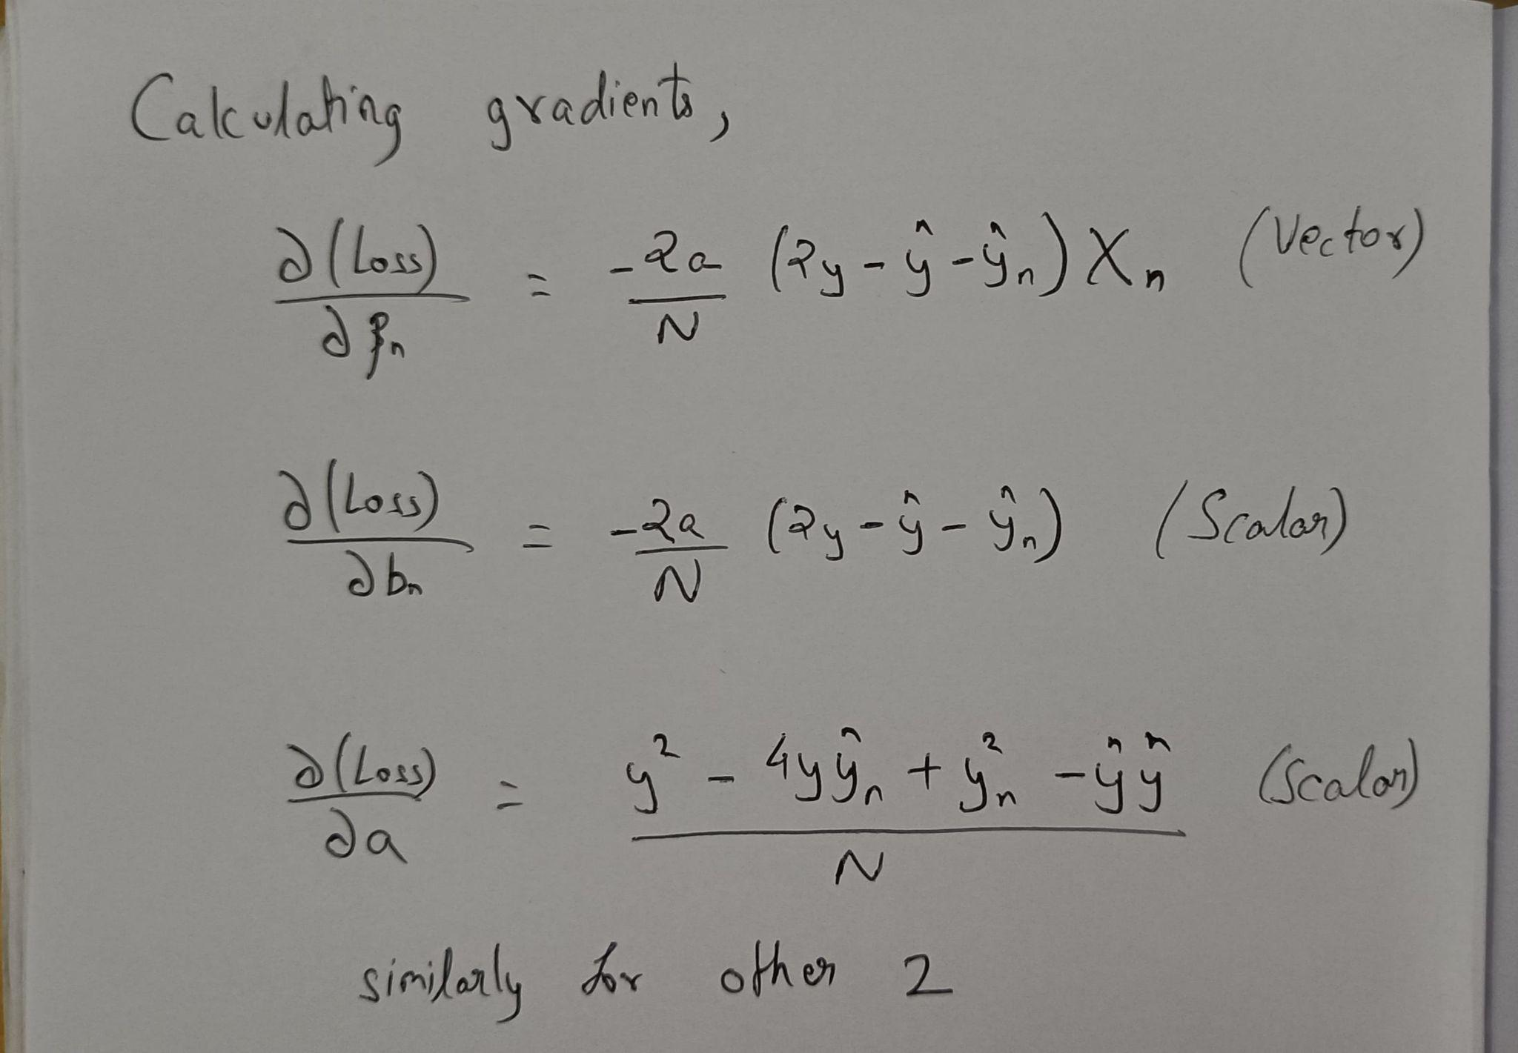
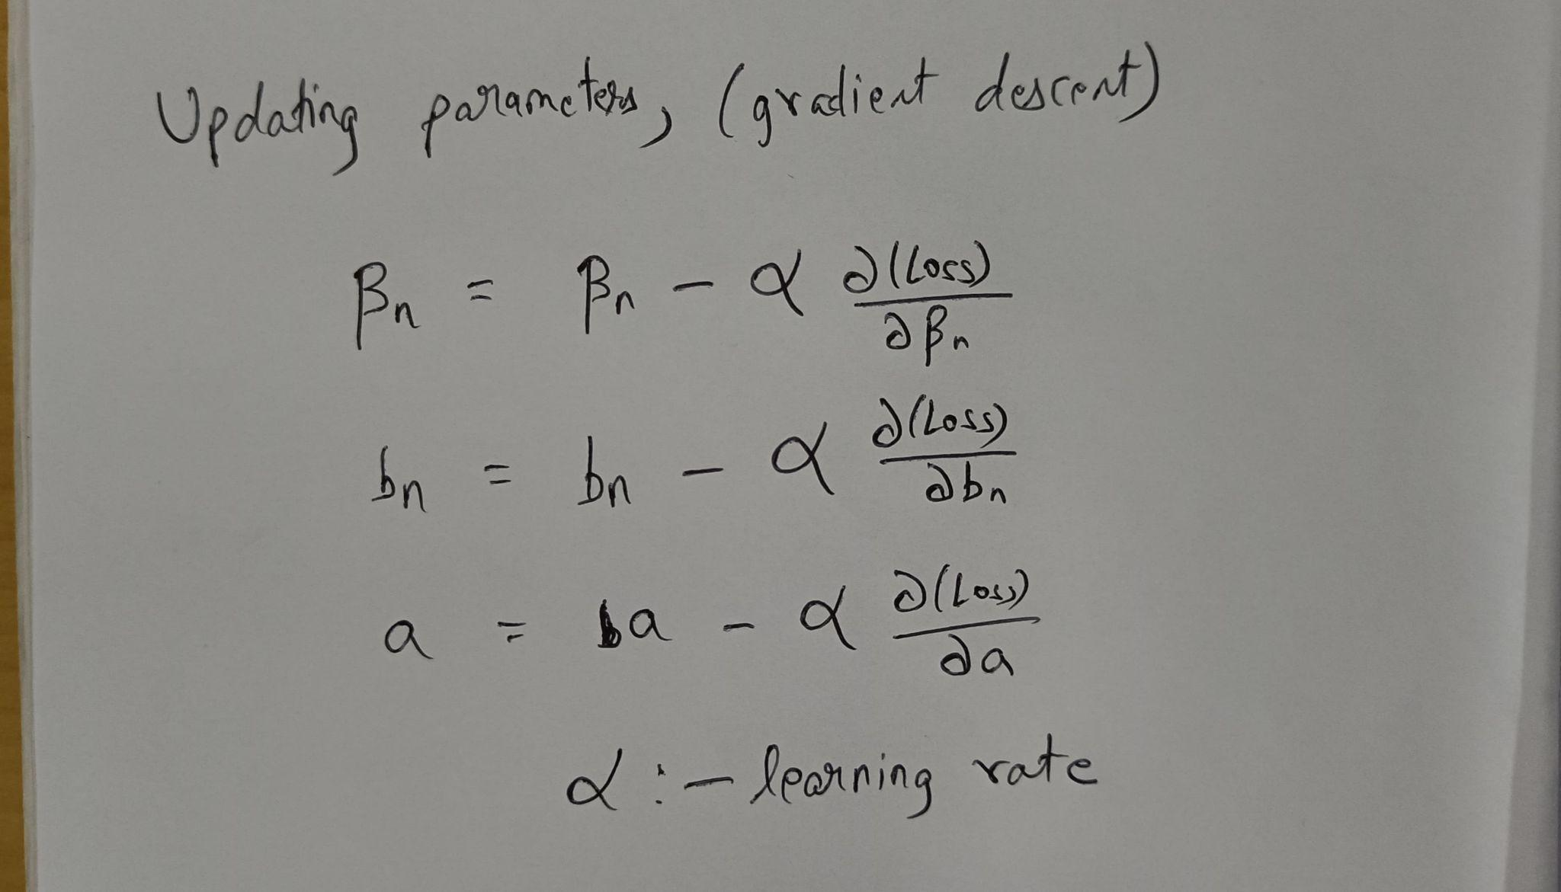
All the parameters
Step 3
Step 4

Slide 5
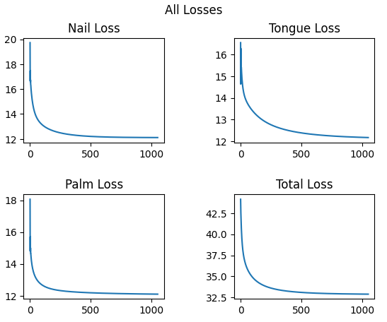

Slide 6
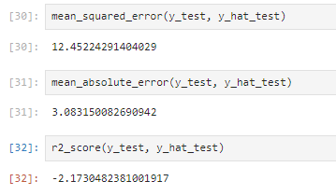
Prediction on test data

Slide 7
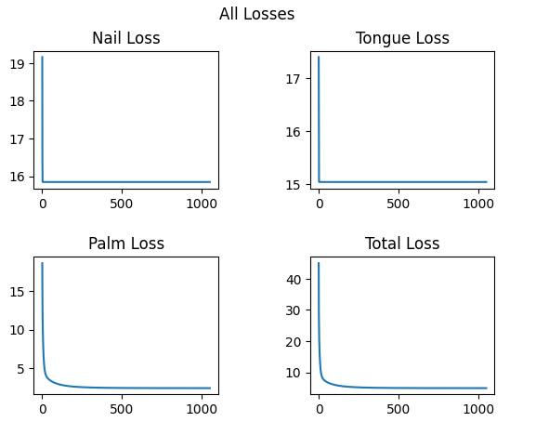
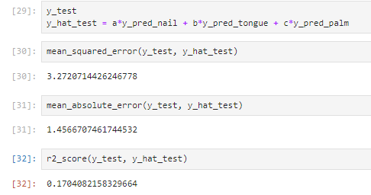
Same model on one anatomy (palm)

Slide 8
TO DOs
Trying out different combining techniques
Eye Annotations after consulting with the doctor

Slide 9
THANK YOU

